Slide 1
BAEEE101 – BASIC ENGINEERING
Module – III – ENGINEERING GRAPHICS & CAD
Lecture – 4
Orthographic Projection
Course Faculty:
Dr. A. Vinoth Jebaraj, SMEC
VIT University, Vellore

Slide 2
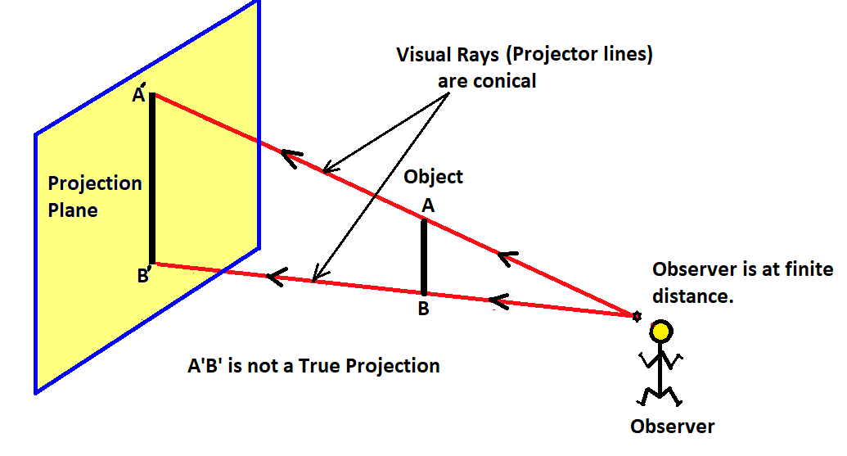
Projection of an Object

Slide 3
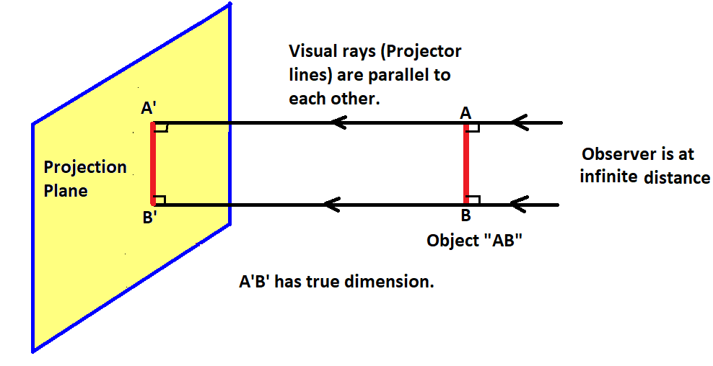
Projection of an Object
Orthographic Projection
“Object is in between observer and the plane of projection”
When the projectors are parallel to each other and also perpendicular to the plane, the projection is called “orthographic projection”.

Slide 4
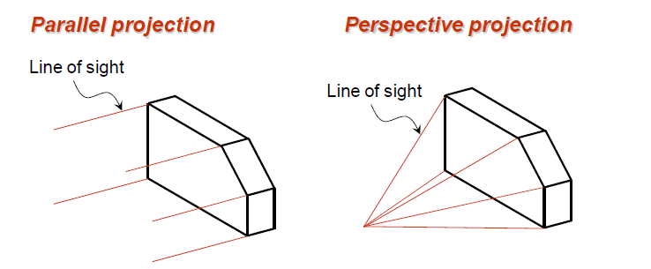
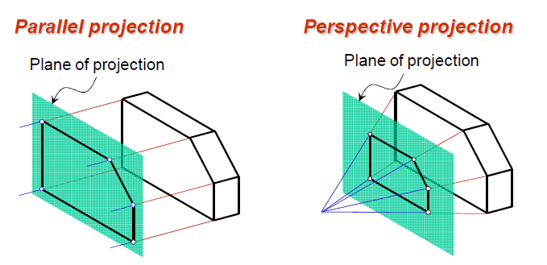

Slide 5
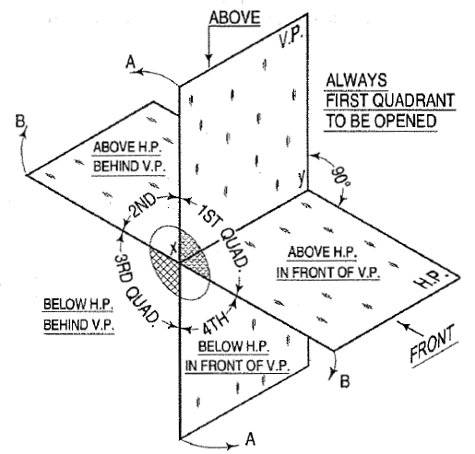
FOUR QUADRANTS
Source: Engineering Drawing, N.D. Bhatt

Slide 6
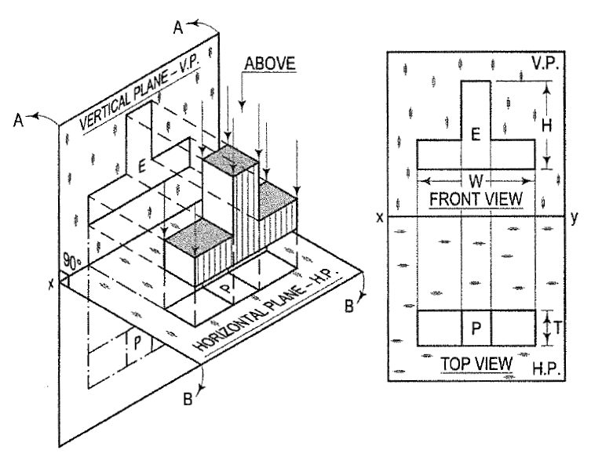
Planes of Projection
V.P. → VERTICAL PLANE
H.P → HORIZONTAL PLANE
FIRST ANGLE PROJECTION
Source: Engineering Drawing, N.D. Bhatt

Slide 7
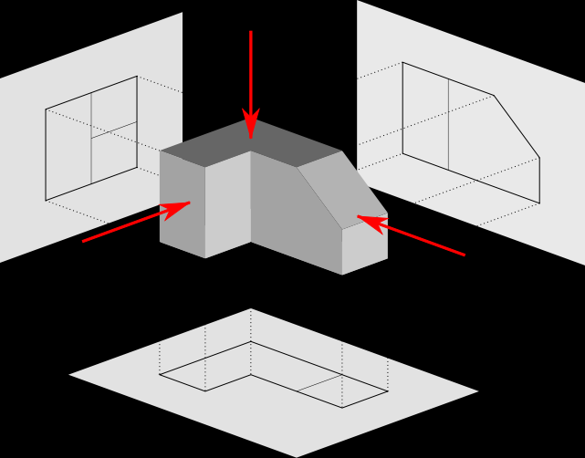
TOP VIEW
LEFT SIDE VIEW
FRONT VIEW

Slide 8
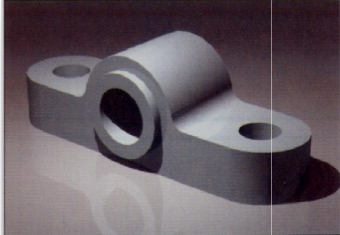
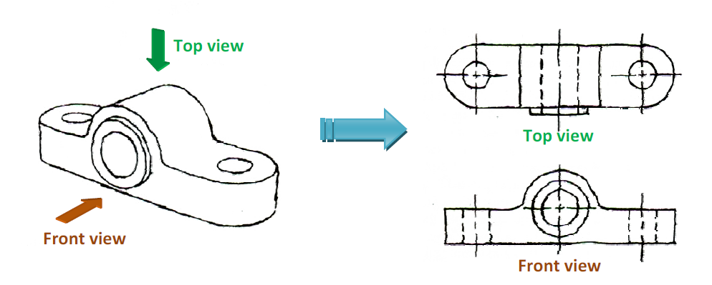
Orthographic Projection of a Product

Slide 9
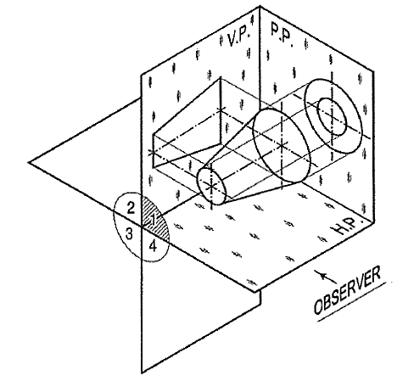
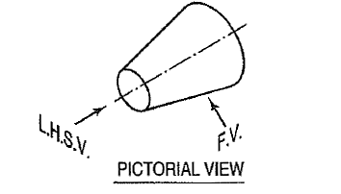
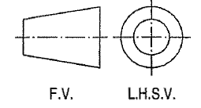
GRAPHICAL SYMBOL OF
FIRST ANGLE PROJECTION
Source: Engineering Drawing, N.D. Bhatt

Slide 10
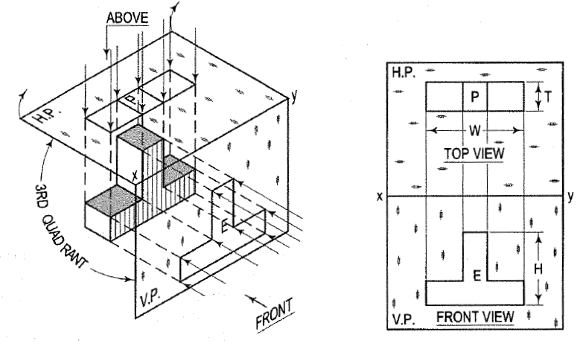
Third Angle Projection
The object is in the third quadrant.
Rays of sight intersect the V.P
Planes of projection are assumed to be transparent
Top view comes above the front view.
Source: Engineering Drawing, N.D. Bhatt

Slide 11
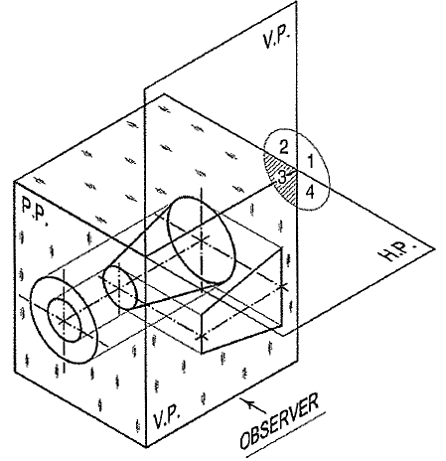
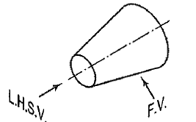
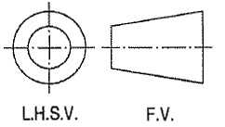
GRAPHICAL SYMBOL OF
THIRD ANGLE PROJECTION
Source: Engineering Drawing, N.D. Bhatt

Slide 12
1st Angle & 3rd Angle Projection – Comparison
First Angle Projection | Third Angle Projection
The object is kept in the first quadrant. | The object is assumed to be kept in the third quadrant.
The object lies between the observer and the plane of projection. | The plane of projection lies between the observer and the object.
The plane of projection is assumed to be non-transparent. | The plane of projection is assumed to be transparent.
The top view (plan) comes below the Front view (elevation). | The top view (plan) comes above the Front view (elevation).
The view of the object as observed from the left-side is drawn to the right of elevation. | Left hand side view is drawn to the left hand side of the elevation.
This method of projection is now recommended by the "Bureau of Indian Standards‘ from 1991. | This method of projection is used in U.S.A. and also in other countries.
Source: Engineering Drawing, N.D. Bhatt

Slide 13
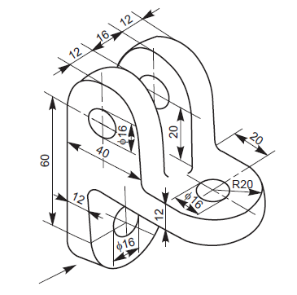
Orthographic Projection - Exercise

Slide 14
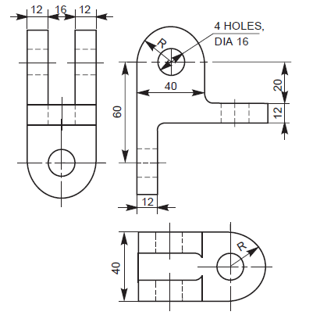

Slide 15
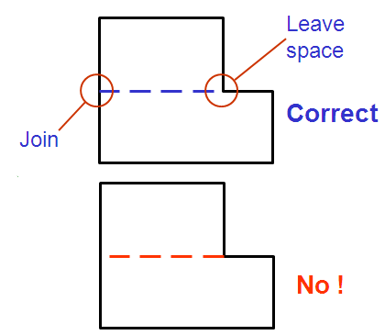
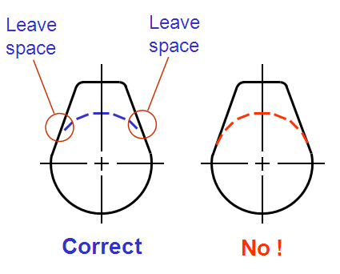
Hidden Edge Representation

Slide 16
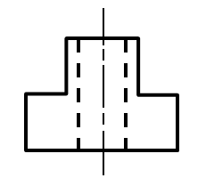
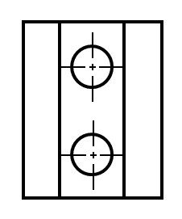
Representation of Holes

Slide 17
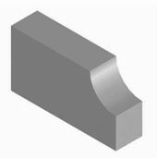
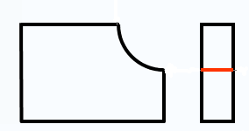

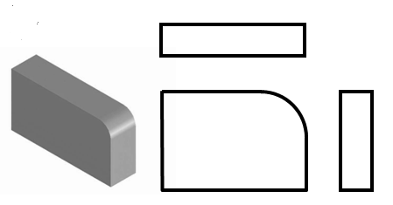
Representation of Edges and Fillets

Slide 18
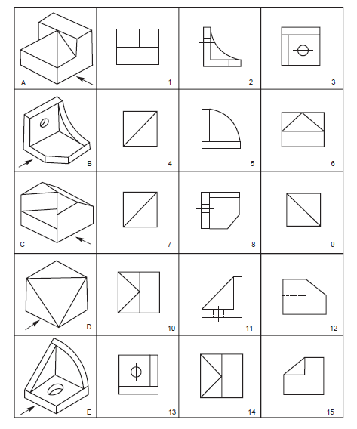
Q. Identify the appropriate orthographic views for the given objects.

